Slide 1
Shunt & Series Motors
Electrical Machines
DC Electrical Machines
Shunt motors • Series motors • Car starter motor circuit
M
Learning focus
Compare shunt and series field connections
Explain why starter motors use a series motor
Use typical starter voltage and current values
Recognise the starter solenoid circuit
TEACHING DECK • 10 SLIDES
Notes:
A 10-slide lesson deck regenerated using the user supplied Matrix master file style.

Slide 2
Field Connections
Electrical Machines
Two common wound-field DC motors
Both are brushed DC motors, but the stator field is connected differently.
Shunt motor: field winding is connected across the supply in parallel with the armature.
Series motor: field winding is connected in series with the armature, so the same current flows through both.
SHUNT FIELD
+
−
parallel paths
+
−
A
SERIES FIELD
ARMATURE
A
ARMATURE
Shunt: near constant field
Series: field strength rises with load current

Slide 3
Shunt Motors
Electrical Machines
Shunt motor: stable speed under changing load
The field current is set mainly by the supply voltage and field resistance.
Main points
Field winding: many turns, relatively high resistance
SHUNT FIELD
parallel paths
Armature current changes with mechanical load
+
−
Good speed regulation for many teaching examples
A
Do not run with field circuit open: speed can rise dangerously
ARMATURE
COMMON USES
Fans, blowers, machine tools, test rigs and applications needing reasonably constant speed.

Slide 4
Shunt Motor Behaviour
Electrical Machines
Shunt motor characteristics
Useful when steady speed is more important than very high starting torque.
Speed
Torque
Load torque
Armature current
Small speed drop as load increases
Torque rises approximately with armature current
For a shunt motor, the field is almost constant, so torque is mainly controlled by armature current.

Slide 5
Series Motors
Electrical Machines
Series motor: high starting torque
The same current flows through field and armature, making the field strong at start-up.
Why torque is high at start
At standstill there is little back EMF
Large starting current flows
+
−
A
Field flux and armature current are both high
SERIES FIELD
ARMATURE
Result: very high starting torque
Important: a DC series motor should not be run unloaded because speed may rise excessively.

Slide 6
Comparison
Electrical Machines
Shunt motor vs series motor
The field connection changes starting torque, speed regulation and safe operation.
Feature
Shunt motor
Series motor
Field connection
Parallel with armature
Series with armature
Starting torque
Moderate
Very high
Speed behaviour
Fairly constant
Varies strongly with load
No-load operation
Avoid field failure
Do not run unloaded
Good examples
Fans, test rigs, constant-speed drives
Starter motors, hoists, traction-style loads
Classroom shortcut: shunt = steady speed; series = strong start.

Slide 7
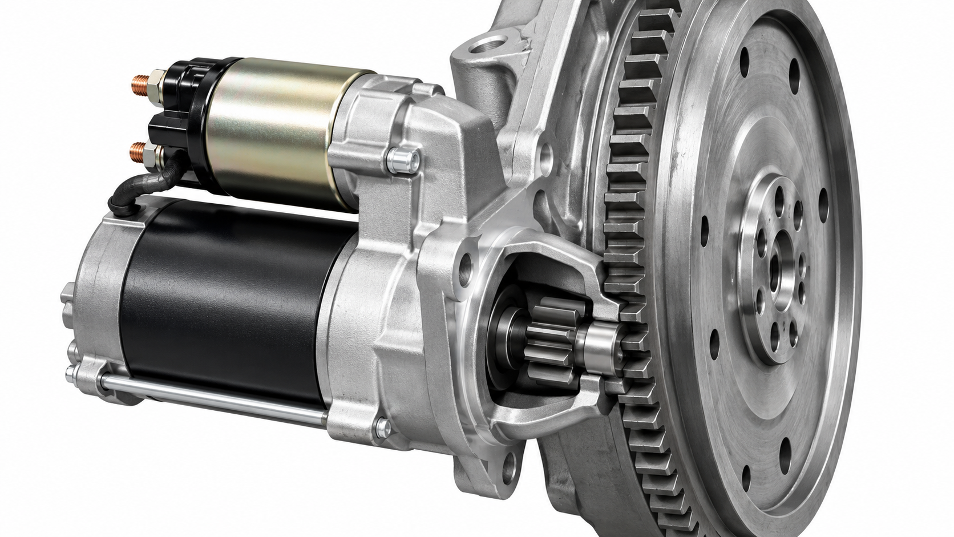
Car Starter Motor
Electrical Machines
Car starter motor: a practical series motor
A starter motor needs a short burst of very high torque to crank the engine.
Why series?
Maximum torque is needed at zero speed
Low supply voltage means very high current
Operation is brief, so heating is managed by duty cycle
Solenoid both switches current and moves the pinion
SERIES MOTOR EXAMPLE
Pinion gear engages the flywheel, then the motor cranks the engine.

Slide 8
Starter Current
Electrical Machines
Example starter motor voltage and current
Values vary with engine size, temperature, battery condition and motor design.
12 V
150–300 A
500 A+
typical light-vehicle battery supply
example cranking current range
possible cold-start or stall peak
Example calculation: P = V × I = 12 V × 250 A = 3000 W ≈ 3 kW
Teaching note: keep starter motor demonstrations controlled; high current can overheat cables and contacts quickly.

Slide 9
Solenoid Circuit
Electrical Machines
Starter circuit with solenoid
The solenoid is both a relay and actuator: it closes the high-current contact and engages the pinion.
High-current motor path
M
Heavy solenoid
contacts
magnetic pull closes contacts
Series
starter motor
+
−
12 V battery
Ignition
START
SOLENOID COIL
Low-current control path
The small START switch does not carry starter current.

Slide 10
Summary
Electrical Machines
Key takeaways
Use the motor connection to predict behaviour and choose the right application.
Shunt motor: field is parallel with armature, giving relatively steady speed.
Series motor: field and armature carry the same current, giving very high starting torque.
Car starter motor: series motor with a solenoid to switch high current and engage the pinion.
Typical example: 12 V system, about 150–300 A cranking and higher cold-start peaks.
Safety reminder: high-current DC systems need short duty cycles, secure connections, suitable cables and guarded rotating parts.
End of section

